Slide 1
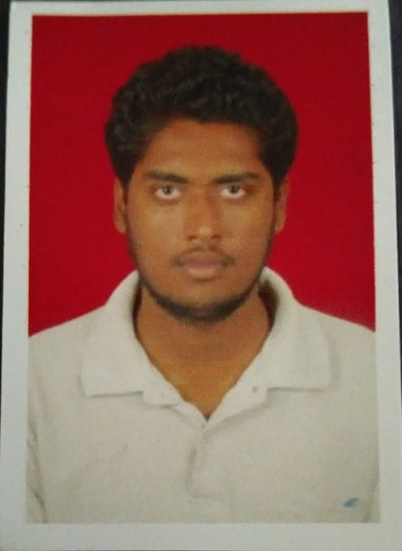
Name : Sourabh Sunil Potdar
Business Title - Firmware Engineer
Education Qualification – Bachelor Of Engineering In Electronics & Telecommunication
Highlights - Total Experience, 5 + yrs
Expertise in Analog, Digital, Mixed and RF system Design for Power, Test & Measuring Instruments, Industrial, Medical, Telecommunication.
Experience in complete Product Life Cycle, Concept, Design, Development, Testing
Experience in system design, Embedded code design, Power supply design and System Engineering
Experience in Circuit Simulation, Signal Integrity Analysis, Error Calculation, Component Selection, Board Bring up, System Testing
Experience in Product Qualification Testing
Core Skill Set: Embedded and automation programming, Board design, System design, System Testing and qualification
Experience: Complex consumer/industrial system design, Battery operated consumer devices, Controller Programming, PCB design, Power Supply Designs, High Power design, RF design
Key projects handled as below:
CBSCAN PA 0304 Circuit breaker analyzer and Test System
Mili-volt Drop and u-Ohm meter
Battery Test system
Motor Torque and burn in monitoring system.

